Slide 1

Kelly Angell
Mission Program Manager
American Cancer Society
563-212-7251
Kelly.angell@cancer.org

Slide 2
You can offer the best cancer treatment options in the world,
but what does it matter if
someone can’t get there?

Slide 3
Road To Recovery Program
Road To Recovery
Patient Eligibility & Guidelines
(How the American Cancer Society Answers the Transportation Need)
Road To Recovery - Volunteer
The Road to Recovery program provide rides to and from cancer-related medical appointments for patients who otherwise might not be able to get there.
Road To Recovery – Partners
The American Cancer Society contracts and coordinates with public transportation vendors and privately-owned transportation companies to provide transportation services to cancer patients.
Hotel Partner Program/Hope Lodge
ACS considers lodging as a transportation solution, which is why ACS is partnered with over 1,000 Hotels nationwide to help provide greatly reduced of complimentary lodging to patients to get to treatment. Hope Lodge also provides a home away from home for patients traveling more than 40 miles one way. There are 4 HP facilities in the Midwest area.
Demonstrate need
Be in active treatment
Rides to treatment-related appts
Be ambulatory
Be free of anesthesia
Be free of infectious disease
Available to all ages*
*18 and under must be accompanied by an adult with proper car seat
_____________________________
Curb to curb
3 business days advanced notice
Patients/providers can call
1-800-227-2345 or visit cancer.org
Notes:
Driver Manual (page 6&7)
Conditions to Provide Transportation
The Road To Recovery program provides curbside-to-curbside service for cancer-related treatments and appointments. Drivers should not lift a patient into or out of a wheelchair, or offer more than a guiding hand or arm to lean on.
Patients must: Demonstrate need: To qualify for transportation through the Road To Recovery program, cancer patients must demonstrate a legitimate need. Either they don’t have transportation of their own or don’t have access to a driver.
Be in active treatment: Cancer patients must be in active treatment and requesting rides for appointments that are treatment specific or for appointments that are required to begin or complete treatment. Follow-up appointments for complementary therapies that are required to begin or continue treatment are also considered for rides.
Be ambulatory: People with cancer must be able to sit, stand, and walk without assistance, or an adult caregiver must accompany the patient. The patient must provide their own walker or wheelchair. If a patient requires a walker or wheelchair, they must have a caregiver with them to manage their medical equipment. Drivers should not be lifting equipment into or out of their vehicle.
Be 18 or older: Patients under the age of 18 must have a parent, guardian, or another responsible adult with them; the Society must get permission (verbal or written) from the patient’s parent or guardian. If the patient requires a car seat (based on state law) the parent, guardian, or responsible adult must provide it and ensure that it is safe and secure.
Be free of anesthesia: Cancer patients must be free of anesthesia or sedation prior to and after the treatment, or they must be accompanied by an adult who will be responsible for the patient’s condition.
Be free of infectious disease: The patient must be free of a communicable disease that is easily passed to any other person by coughing or sneezing such as the flu, or if they do have a communicable disease they must take proper precautions such as wearing a mask to prevent the spread of disease.
If the patient has an infected wound, then it must be covered with a dressing that prevents any wound drainage from getting on the inside of the car.
Rides cannot be provided for the following services:
• Support group services
• Screening appointments
• Diagnostic appointments
• Lymphedema therapy
• Physical therapy that does not affect the ability of the patient to begin or continue active cancer treatment
• Long-term dialysis that does not affect the ability of the patient to begin or continue active cancer treatment
• Mental health services
• Alternative therapies (non-standard treatments of cancer)
• Personal errands or other rides not specific to cancer treatment

Slide 4
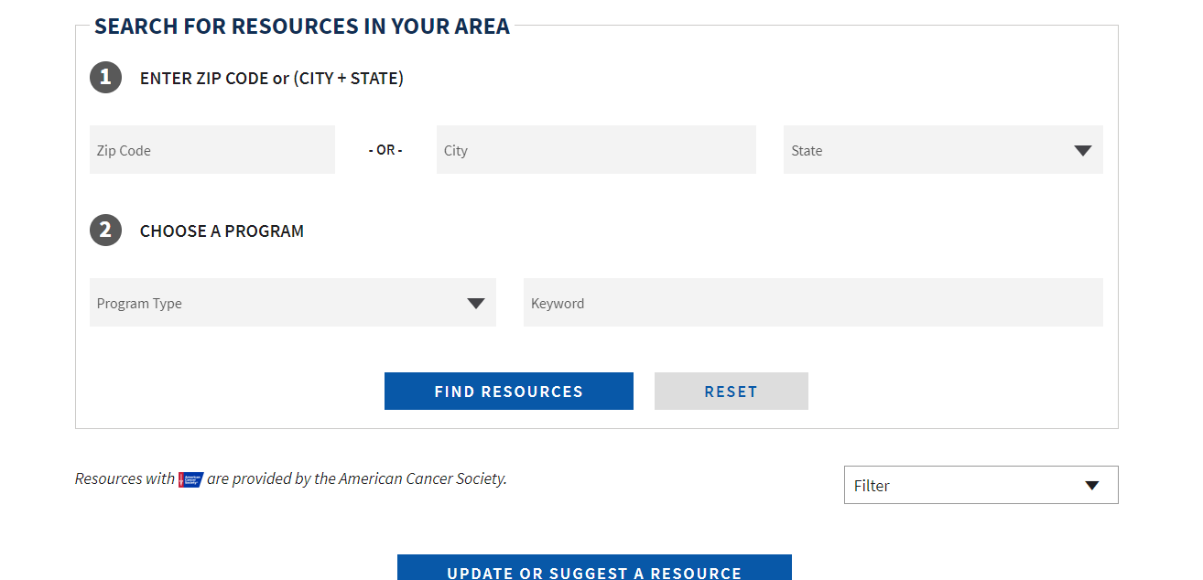
Cancer Resource Connection – Referrals and Help
1). Go to www.cancer.org
2). Click on treatment and support
3). Scroll down, click on Support in Your Area
4). https://www.cancer.org/treatment/support-programs-and-services/resource-search.html

Slide 5






ICC Implementation Grant: Transportation Improvement
Goal 1: Increase collaboration among organizations, coalitions, businesses and individuals to maximize cancer control resources and efforts.
Goal 10: Increase access to quality cancer care and services.
Goal 13: Increase access to and awareness of quality-of-life services available to cancer patients during and after cancer treatment.
Goal 14: Improve the health equity of cancer control interventions and services.
Goal 15: Increase access to cancer related data, and educate Iowans on ways to apply data to cancer control activities.

Slide 6

Project Objectives
ONE: Increase the number of cancer patients served with transportation through increased transportation options and volunteers.
Improve resource knowledge
Find regional vendors who can meet patient needs at low cost
TWO: Engage stakeholders in the design of solutions for sustainable transportation resources, through meetings, education, training, and data collection.
Work with cancer centers to understand transportation issues
Build relationships and understanding and education

Slide 7




2 workgroup meetings
3 in person staff trainings

Slide 8

MAKING THE CONNECTION
Mobility Management
Mobility Management is an innovative approach to managing and delivering coordinated services to customers; including low-income, older adults, and persons with disabilities
Person centered approach, assisting with the whole trip, while using multiple modes of transportation
and not just public transit
Mobility Managers not only assist in navigating the system, but can also engage with community planning, outreach and marketing, community events and cross promotional activities with other agencies

Slide 9
PUBLIC TRANSIT IN IOWA
3 types of public transit
ADA Complementary Paratransit is provided by the 19 urban transit agencies in, at a minimum, ¾-mile around a fixed route
  Passengers must apply, meeting ADA qualifications in order to ride
  Ride reservations are arranged by the rider at least one day prior for a desired trip
  Bus picks the passenger up at their location, taking them to the desired destination
  Fares for this origin-destination services may be no more than double the regular fixed route fare

Slide 10
What does success look like?
Increase of:
Patients successfully served with transportation
Resource sharing
Introductions between providers
Knowledge and confidence in available resources
Investments in patient transportation
Decrease of:
Patients missing appts or delaying treatment
Unmet ride requests
Time spent on transportation arrangement
Ultimately –
Improving health outcomes

