Slide 1

Public Transit and Paratransit Programs in Kansas
Early Detection Works
Cory Davis/Rene Hart
May 8th, 2019

Slide 2
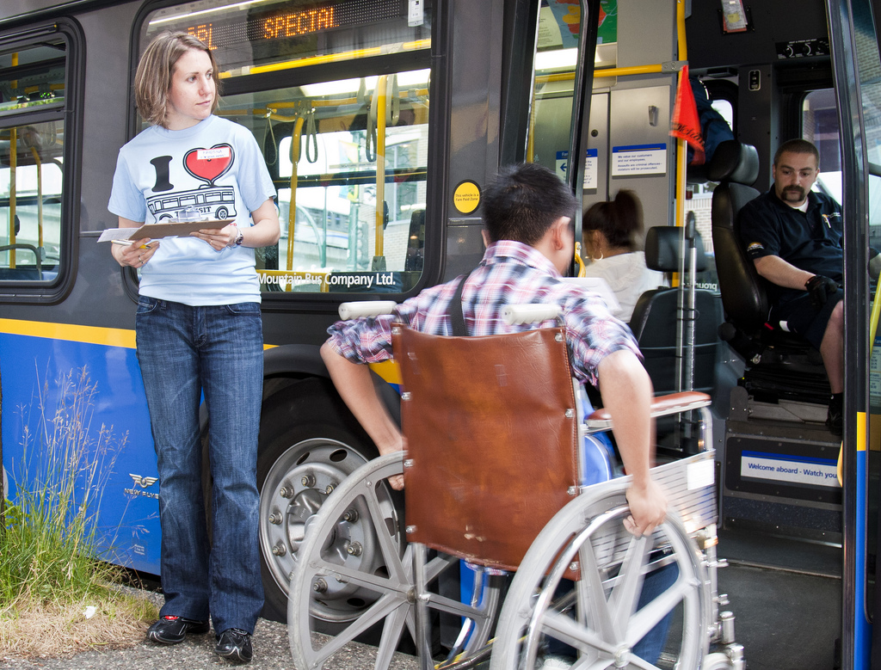
What is transit?
Transportation designed for people who choose not to or aren’t able to drive
Critical part of our transportation network
In 2016, Americans took 10.4 billion trips on public transportation
    Kansas ~10 million

Slide 3
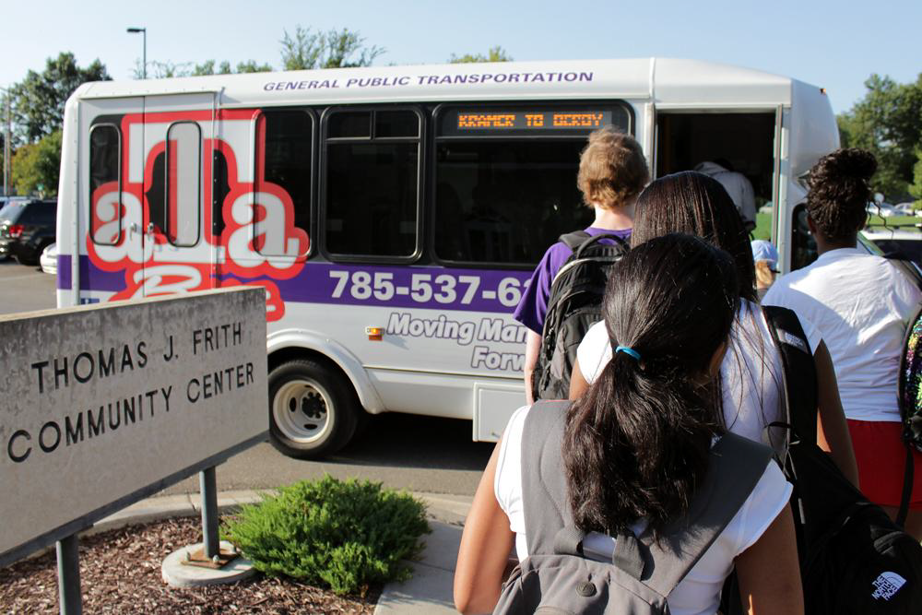
Why is transit so important?
Local and long distance connections
Provides access to goods, services, and other people
    Shopping, entertainment
    Medical, educational, religious
    Family, friends, events
Increases mobility
Encourages aging in place
Supports local economies

Slide 4
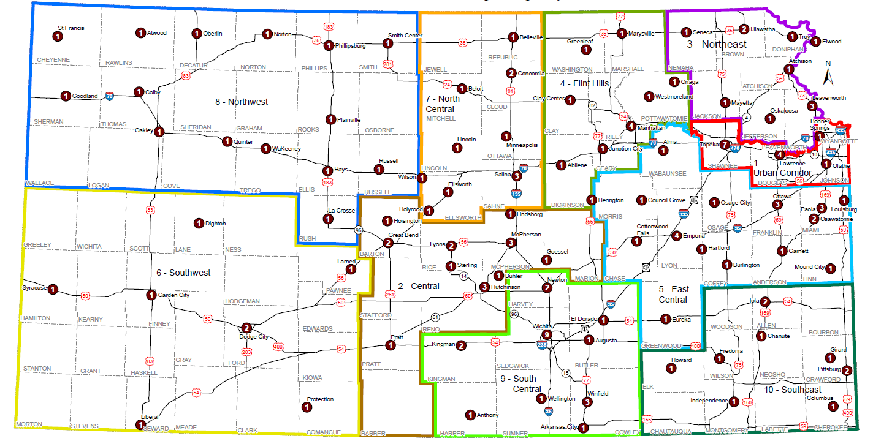
Where is transit?

Slide 5
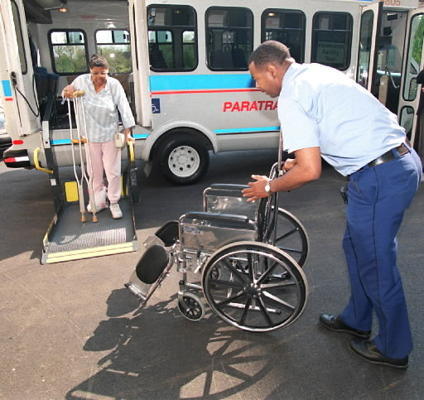
Types of transit – Client Specific
Nursing home
Senior center
Medical facility

Slide 6
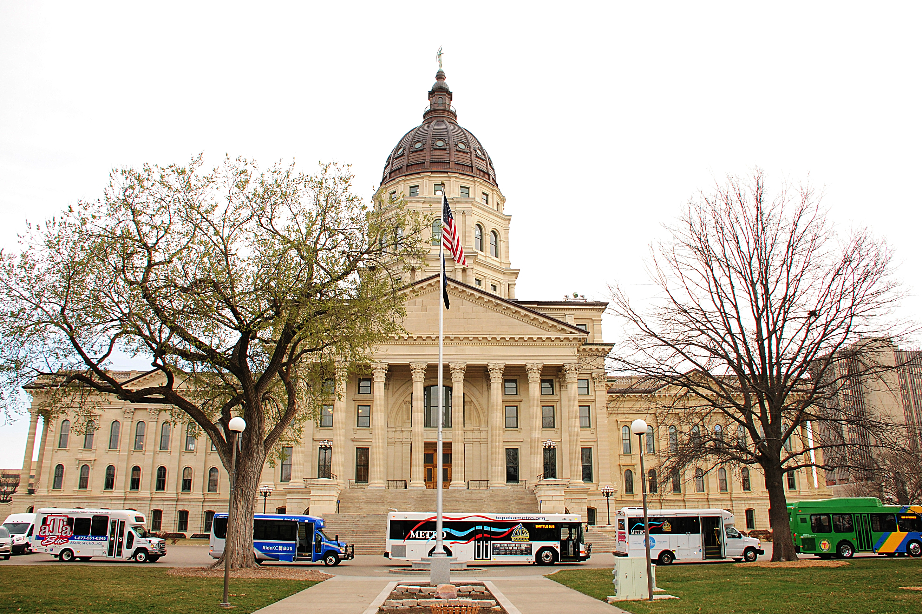
Specific KDOT Programs
5311 – General Public Transportation
5310 – Elderly and Disabled
5339 – Bus and Bus Facilities
State Funding
    Operations support
    Technology
    Long-range planning
    Mobility management

Slide 7
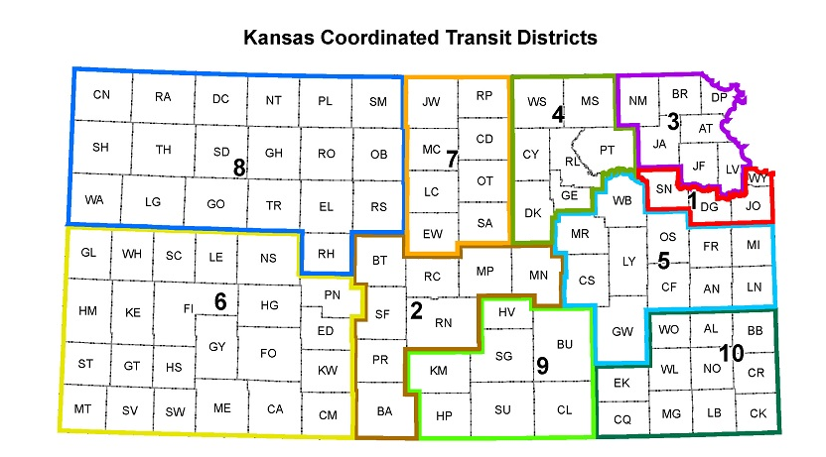

Online Resources

Slide 8
Regional Business Model
Transit Business Model Strategies
Regional Routes – Multiple providers share responsibility - preventing duplication
Coordinated Scheduling –Provides providers with knowledge and details of other trips in their area
Mobility Management –Regional resource rider training, outreach, coordination with employers, medical centers, and human services agencies
Regional Governance Structure – Framework for REGIONAL decision-making for COORDINATION
Branding Elements – Convey the connection between the provider, the CTD, and KDOT’s public transportation program
Notes:
Completed in 2014 – The purpose of this initiative was to develop a model for us to best utilize our public transportation resources in the most efficient and effective way. We met with transit agencies and stakeholder across the state and identified practical strategies that we could implement. One thing we did was to condensed our Coordinated Transit Districts from 15 to 10 based on travel patterns and population. Among other strategies were:
Regional Routes that make logical connections between communities and prevent duplication of service.
Coordinated Scheduling allows transit providers to share route information and coordinate passenger trips when they move from one jurisdiction to another.
Mobility Management establishes a key resource for each CTD who can advance strategies by bringing different agencies together.
We also seek to strengthen the governance structure of our CTDs so they advocate for their transportation needs and be a regional decision making voice for their district.
Branding elements allow to better convey the connections between providers, the CTD our public transportation program.
These key strategies have allowed us to obtain cost savings, increase service availability and enhance coordination between providers. We now have several regional routes: The 81 Connection operates from Belleville to Salina 3 X a day and connects
to local transit series along the way. The route has allowed for a more direct, cost-effective connection for residents in rural communities to access healthcare in Salina. We also have a regional route from Emporia to KC and Wichita, as well as a route from Manhattan to Junction City and Wamego, and are exploring a route from Manhattan to Salina.
We also now have 2 MM in place with several more coming on board soon.

Slide 9
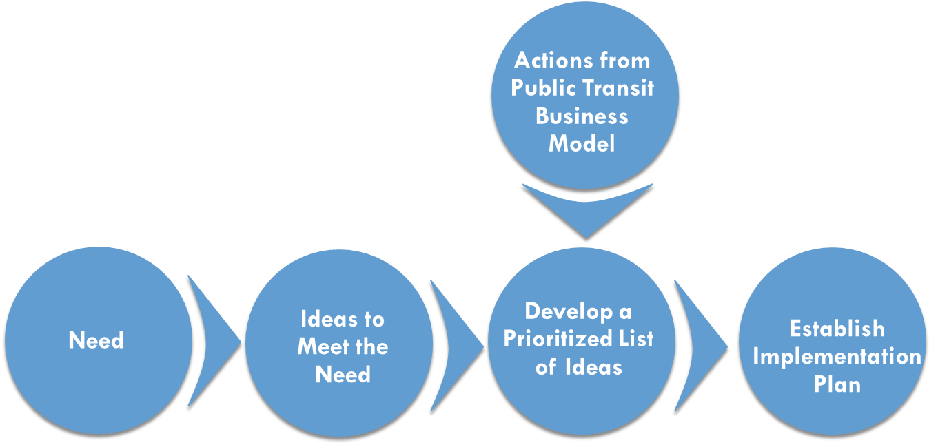
Coordinated Plan – Linking
Transportation and Human Services
Coordinated Public Transit-Human Services Transportation Plan
Targeted Populations:
  Seniors
  Low-Income Persons
  Persons with Disabilities
Notes:
The Coordinated Plan is a federally required plan under FTA to strengthen the connection between public transportation and human services for seniors, low-income persons and individuals with disabilities. The plan looked at existing services and identified the transportation needs of the targeted groups. It was recently developed through a process involving many different stakeholders from across the state. An 11 member steering group representing Statewide Human Service Organizations acted as a sounding board for us along the way. Some of agencies represented were the AARP, Kansas Association of AAA, KS Commission on Disability Concerns, the Kansas Council on Developmental Disabilities and the Statewide Independent Living Council of KS among others. We held meetings across the state with transit providers and the public and brainstormed strategies to address the identified gaps. From this list we prioritized them based on several factors such as local support, ease of implementation and cost. From there we developed implementation plans for each CTD to address the local needs.

Slide 10
Coordinated Plan- Findings and Strategies
Common Areas of Needs Identified
  Public Awareness
  Meeting Future Demand
    Funding
    Driver Shortages
    Increase is Enhanced Care Rides
  Communication among agencies and between CTDs
Most Widely Supported Strategies
  Expand Mobility Manager Coverage
  Marketing/Branding & Outreach
  Promoting Community Benefits of Service/Coordination
  Service Clearinghouse and Shared Data
  Colleague Experience Sharing
Notes:
Over all from a statewide perspective several common areas of need arose to the top. Despite the availability of general public transportation in some areas we still heard that people were unaware of the services or that they could utilize them. For now transit agencies feel that they are currently able to meet most of the need, but worry about future demand as more people age and require more resource intensive trips such as chemotherapy and dialysis. Driver shortages are also a concern. There is real need to continue communication efforts among agencies and between CTDs to be able share resources and make them stretch further. Securing local match from small rural communities remains a challenge.
The most widely supported strategies revolved around expanding Mobility Management coverage to further the collaboration among agencies including human service agencies. Allowing agencies to share data, resources and experiences. Marketing and outreach to let people know about existing transportation services and educating local officials about the importance that public transportation plays in allowing residents to remain in their homes and age in place was also important.
As coordination efforts further develop there is a great potential for enhancing existing and developing new partnerships with human service agencies and medical providers in particular to address the need of access to healthcare particularly in rural areas. We are vey excited about this opportunity we have with your and the Kansas Cancer Partnership.

Slide 11
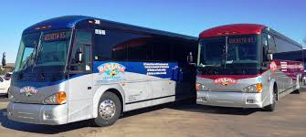
Inter-City Bus Service
Current Routes
  Wichita to Salina- Village Tours
  Wichita to Joplin, MO- Village Tours
  Kansas City to Salina- Greyhound
  Kansas City to Tulsa, OK- Jefferson Lines (Marketing Assistance)
Notes:
We also have an inter-city bus program that assists in providing inter-city and cross country access for people who have longer distance travel needs. We currently have 4 routes as part of our program- In the near future we will be updating our Inter-City Bus Plan as well. Our previous efforts with he Regional Model and the Coordinated Plan will give us insight into how to further regional coverage across Kansas and with our border states.

Slide 12
Questions?
Cory Davis
Assistant Bureau Chief of Transportation Planning
Kansas Department of Transportation
785-296-7984
Cory.Davis@ks.gov

