Slide 1
Virtual Midwest aonn+ Network webinar
May 21, 2020

Slide 2
Virtual Midwest AONN+ Network
Agenda
Introductions
Welcome to all new members
Needs Assessment
http://bit.ly/NetworkNeeds
Leadership Roles
Presenters
Questions???
Topic Ideas for next call

Slide 3
Virtual Midwest AONN+ Network
Virtual Network
Mission (DRAFT)
The mission of the Virtual Midwest Regional Navigator Network is to provide an open forum for navigators focused on excellence of care shared educational opportunities, knowledge, networking, collaboration, advocacy, and outreach and extend the national AONN+ mission. The Virtual Midwest Regional Navigator includes Iowa, Kansas, Missouri, Nebraska and is open to others interested in joining. (this region was once known as MINK)
Vision (DRAFT)
The vision of the Virtual Midwest Navigator Network of AONN+ is to build regional, collaborations among navigators who serve patients in rural communities to share resources, education, and knowledge to help communities meet the needs of their patients and support team while reducing barriers to care.

Slide 4
Virtual Midwest AONN+ Network
Leadership Roles
Chair duties include the following:
Leading the Virtual Meetings
Based off feedback from the call the Chair and Chair Elect will develop the agenda for each meeting.
Lead the revision of the Virtual Midwest AONN+ Network’s mission, vision and goals.
Serve as a liaison between national AONN+ and the Virtual Midwest AONN+ Network.
Two-year commitment
Chair Elect duties include the following:
Based off feedback from the call the Chair and Chair Elect will develop the agenda for each meeting
Review minutes prior to distribution.
Two-year commitment
The Chari Elect will resume the role of the Chair in the follow situations
Absence of the Chair
Inability of the Chair to act
Resignation of the Chair
If you are interested in either of these roles please email Trish Long directly at
Plong@kumc.edu

Slide 5
Virtual Midwest AONN+ Network
Presenters
Ashley Campbell has been an Oncology Field Reimbursement Manager at AstraZeneca for over 5 years Her experience is in multiple launches for orals and infusible products.
Lynda Cozad is here to review the patient access and reimbursement programs available for oncology patients. Lynda is a Field Reimbursement Manager with Pfizer Oncology. She is a Certified Professional Coder with a specialty certification in Hematology and Oncology. In addition to reviewing the available patient programs, she will highlight how she can help support patients when you face challenges or have an urgent situation.
Ryan Soukup is with Amgen Oncology and is their local Kansas City Amgen Oncology Representative covering the Kansas City metro and surrounding areas. Ryan will talk about Amgen Assist 360.

Slide 6
Ashley Campbell
Oncology Field Reimbursement Manager MO/KS/AR
Ashley.Campbell@astrazeneca.com (816)547-5745
www.myaccess360.com
May 2020

Slide 7




Connecting patients to personalized support. Together.
At Pfizer Oncology Together, patient support is at the core of everything we do. From helping to identify financial assistance options to connecting patients to resources for emotional support, the needs of patients prescribed Pfizer Oncology medications are our priority.
ACCESS & REIMBURSEMENT SUPPORT
Resources to help patients receive their prescribed Pfizer Oncology medication in a timely manner, including benefits verification and information related to prior authorizations, appeals, product distribution, and billing and coding.
PATIENT FINANCIAL ASSISTANCE
Help identifying financial support resources for patients, regardless of their insurance coverage.
PERSONALIZED PATIENT SUPPORT
Connections to resources that may help patients with some of their day-to-day challenges.*
Dedicated Local Support
Pfizer Oncology Field Reimbursement Managers (FRMs) can help address challenging or urgent Pfizer Oncology patient access cases.
YOUR FRM CONTACT Lynda Cozad
618.407.5586
LYNDA.COZAD@PFIZER.COM
*Some services are provided through third-party organizations that operate independently and are not controlled by Pfizer. Availability of services and eligibility requirements are determined solely by these organizations.

Slide 8

Ryan Soukup
Amgen Oncology
Sr. Oncology Specialist
Cell: 913.202.2982
rsoukup@amgen.com | www.amgen.com

Slide 9


Slide 10
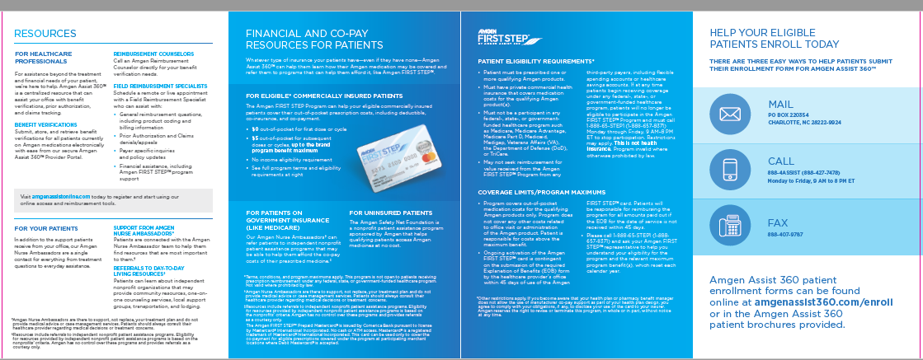

Slide 11
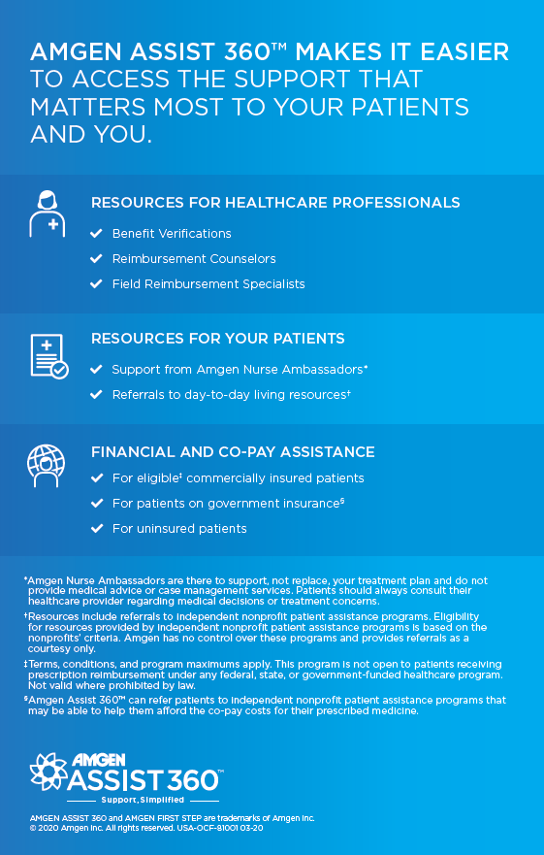

Slide 12
Virtual Midwest AONN+ Network
QUESTIONS ????

